Slide 1
Concepts of Biology Biol 111 Minot State University
Lecture, MWF 12:00-12:50 pm
Cyril Moore Science Center, Room 16
Lab, Tuesdays/Thursdays
Swain Hall, Room 304

Slide 2
Lecture 33 April 30, 2018
Announcements—
Clarification---Final exam---TUESDAY—May 8th—12-1:50. 100 points.
Exam 5---Wednesday May 2nd ---Topics list was reviewed Friday. Posted to website
Exam 5 grade sheet will be available outside my office by Friday, May 4th.

Slide 3
Where were we?...
Modern genetic technology—Recombinant DNA technology
Gene altering techniques
Linking what we have learned to biodiversity.

Slide 4
CRISPR-CAS9 gene editing
One of the most exciting techniques for studying genes is a system used in nature by bacteria called CRISPR or CRISPR-CAS9
It allows scientists to target single genes and remove/destroy or change them in a cell or embryo.

Slide 5
Why?
Removing a gene’s protein product allows us to understand its importance and its role.
Traditionally this has been done by gene “knock out” techniques in mice—This has been powerful, but can take years to develop the mice.
CRISPER technology being expanded to change genes---to possibly repair disease-associated mutations.
Why is CRISPER somewhat controversial?

Slide 6
Where have we been this semester? Connecting concepts….
From atoms to molecules to cells to organisms to populations of organisms…and finally to thinking about the source of diversity of life.
Biodiversity reflects genetic diversity---and you are now experts at genetics and gene expression!

Slide 7
Months ago we defined life and discussed a point in time where molecules organized into a primitive cell. (about 3.5 billion years ago)
This, we would consider the ultimate common ancestor!

Slide 8
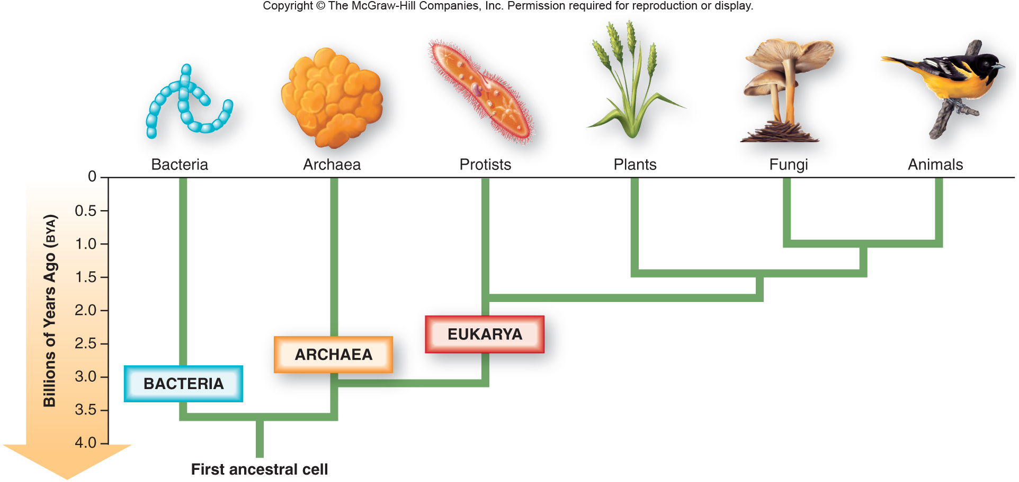
Fig. 1.4
Came into existence when some genetic molecule (likely RNA or protein) became enclosed in something like a membrane

Slide 9
Charles Darwin is given credit for noticing both the similarities and differences in living things. He was a “naturalist”.
Darwin, of course, knew nothing of the details of cells, DNA, gene expression…
But he was the first to get us to think about the biology behind a tree of life.

Slide 10
Darwin and another naturalist shared the same interest and the same focus of study.
…to explain the diversity of life, and the relatedness of organisms.
The other naturalist was named Alfred Russel Wallace.

Slide 11
Darwin and Wallace
Both took several bodies of knowledge and combined them into one hypothesis.
They studied geography. They noted the existence of certain species in specific places.
Similar species seemed to come from physically linked places. The more disconnected physically, the more differences they saw in groups of living things.

Slide 12
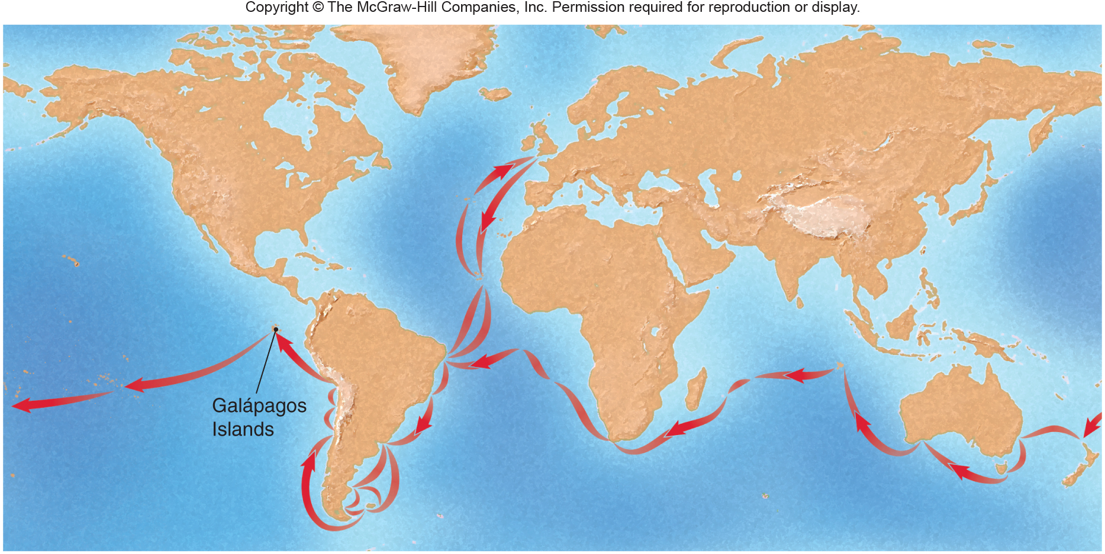
Darwin’s travels
1. He travelled to different but adjacent continents. (including many islands)

Slide 13
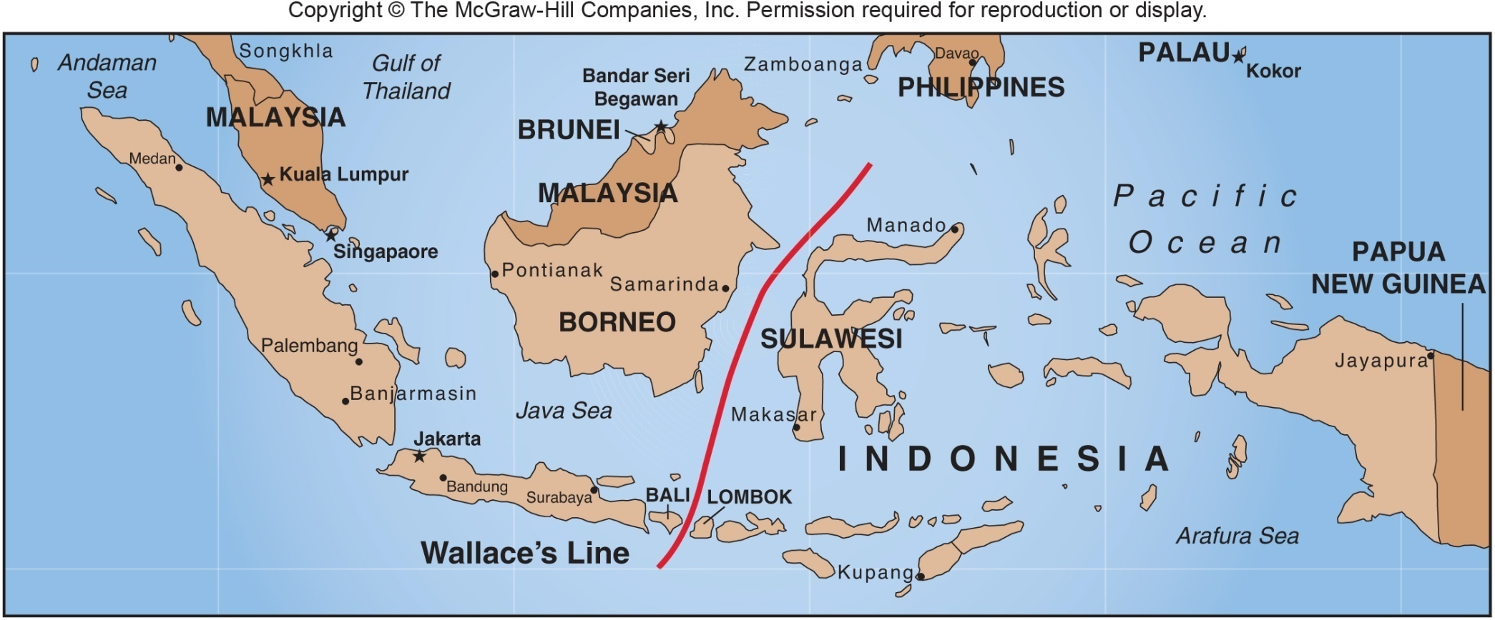
Fig. 14.11
Wallace’s travels

Slide 14
Both observed and collected lots of samples of living things and looked at the remains of dead things in the form of fossils.
They noted common features in birds, reptiles, mammals, sea creatures, like molluscs

Slide 15
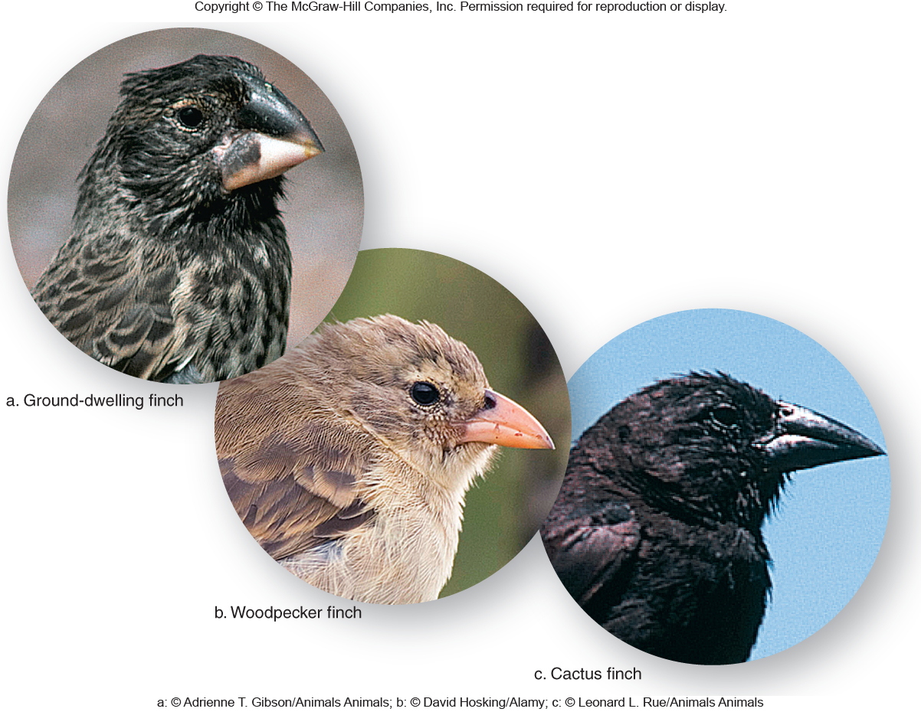
Fig. 14.6

Slide 16
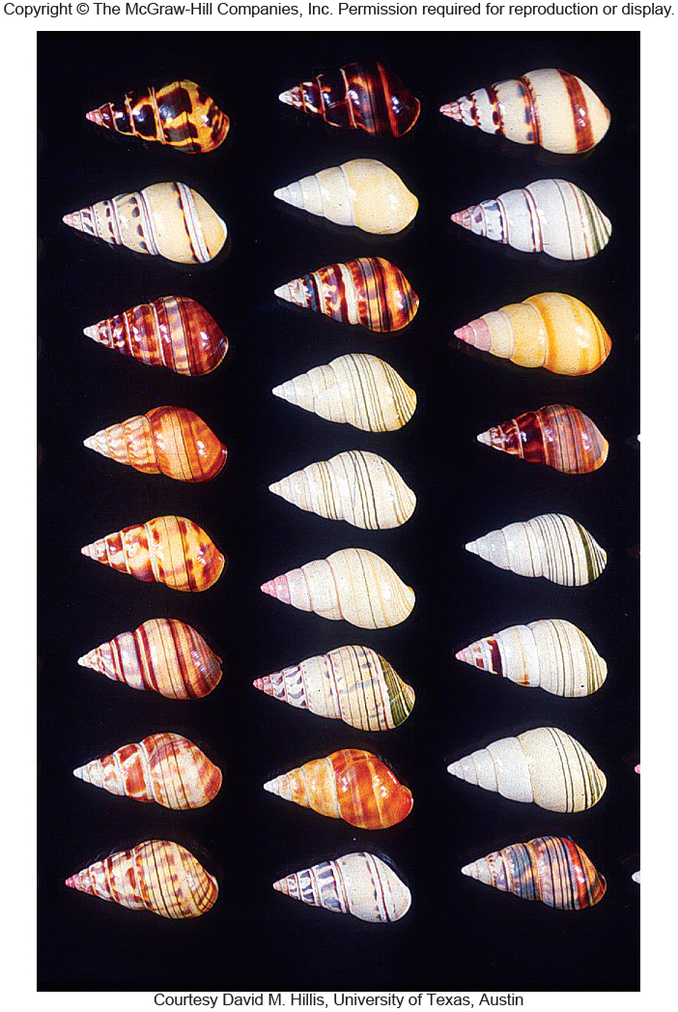
Fig. 14.7

Slide 17
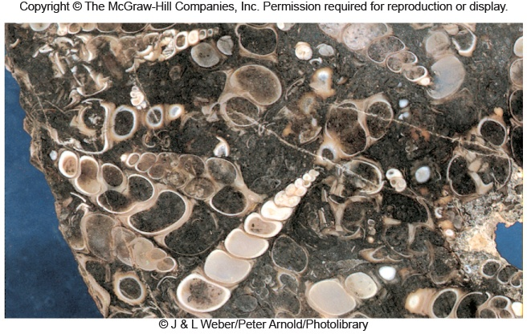
Fig. 14.3b

Slide 18
They both considered that the earth was old and that different organisms developed throughout the history of the earth (after all--- they found evidence in fossils)
No one could deny that the remains of living things were represented in these fossils
Things that were alive together would be found as fossils, together.

Slide 19
Darwin and Wallace actually shared their ideas about how new species came to be. Darwin was amazed that someone had the same hypotheses as he did.

Slide 20
The basic idea…of Wallace and Darwin.
Every new species has come from a pre-existing one that existed in both the same physical space and time.
The further away in space and time, the less living things resemble each other.

Slide 21
How do they explain the gradual changes and the existence of so many species?
At term Wallace called “survival of the fittest”
At term Darwin called “natural selection”

Slide 22
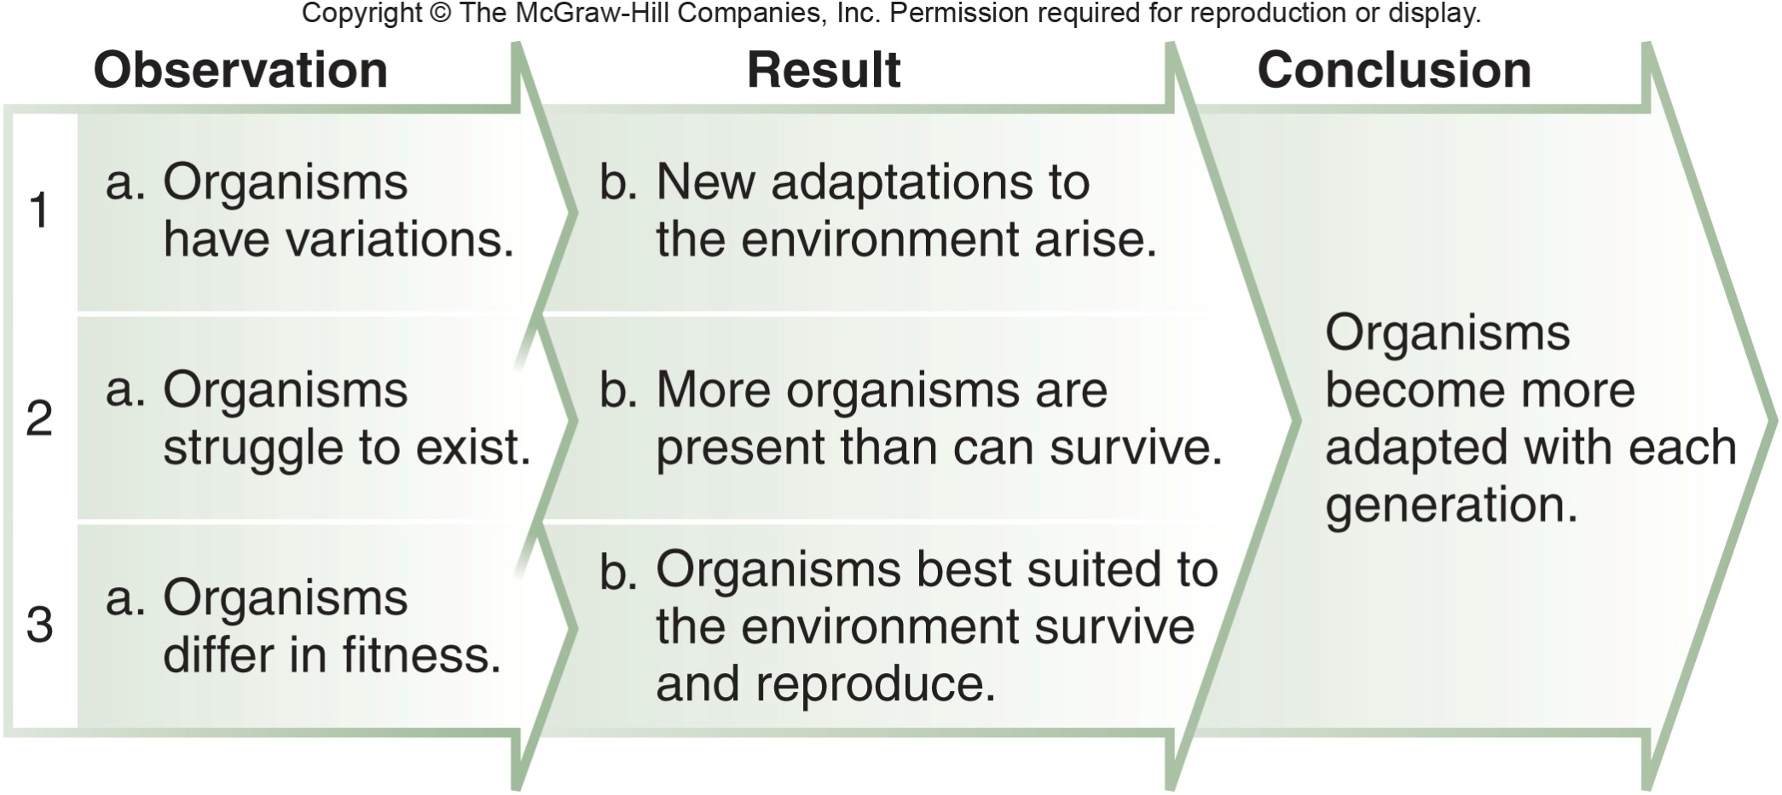
Page 247

Slide 23
The absolutely essential detail is that the variation comes from genes (different alleles) and that the “fittest” individuals pass those useful alleles on to offspring.

Slide 24
Evidence for Evolution
Fossil evidence:
Fossils found in the earth layers deemed to be the same age look similar.
2. Several so-called transitional fossils have helped us to understand the order in which groups of animals evolved…There are fossils that look like fish that could walk, and reptiles that had feathers.

Slide 25
We’ve learned from the fossil record that fish came before amphibians, which came before reptiles, which came before birds… All because some animal existed that shared features of 2 types of animals---and we know when those fossils were made. (Because geologists can tell us how old a certain layer of earth is!)

Slide 26
For example, since fish lived before there were any land creatures, some fish had to have developed something that resembled legs or arms to be able to leave the sea.
We have found fossils of something that resembled a fish, but had features of amphibians, including rudimentary limbs

Slide 27
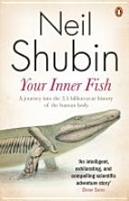
The best book I’ve read on the subject is Your Inner Fish, by Neil Shubin.
Tiktaalik roseae the fish with hands

Slide 28
Biogeographical evidence:
Related species are found in one locale and spread only to connected areas.
We can estimate when certain land masses spread apart and this coincides with the major changes seen in species.
The study of island species really helped Darwin and Wallace understand this. Darwin noted that birds that lived on nearby islands seemed similar, but also uniquely adapted to live in a different environment.

Slide 29
Darwin’s most famous records of variation came from observations of finches on the Galapagos Islands—
Darwin hypothesized that the primary difference in the finches was related to the food sources on each island. Small beaked birds were found where small seeds were the main sources of food. Birds with sturdier beaks were found where food like large nuts were the main source of food…

Slide 30
In a sense, every land mass/continent is an island that has broken away from an original larger land mass.
The complementary shapes of the continents show us the land of the earth was originally more continuous---Pangaea.

Slide 31
Pangaea to present day….

Slide 32
Recall…Darwin’s travels…
1. He travelled to different but adjacent continents. (including many islands)

Slide 33
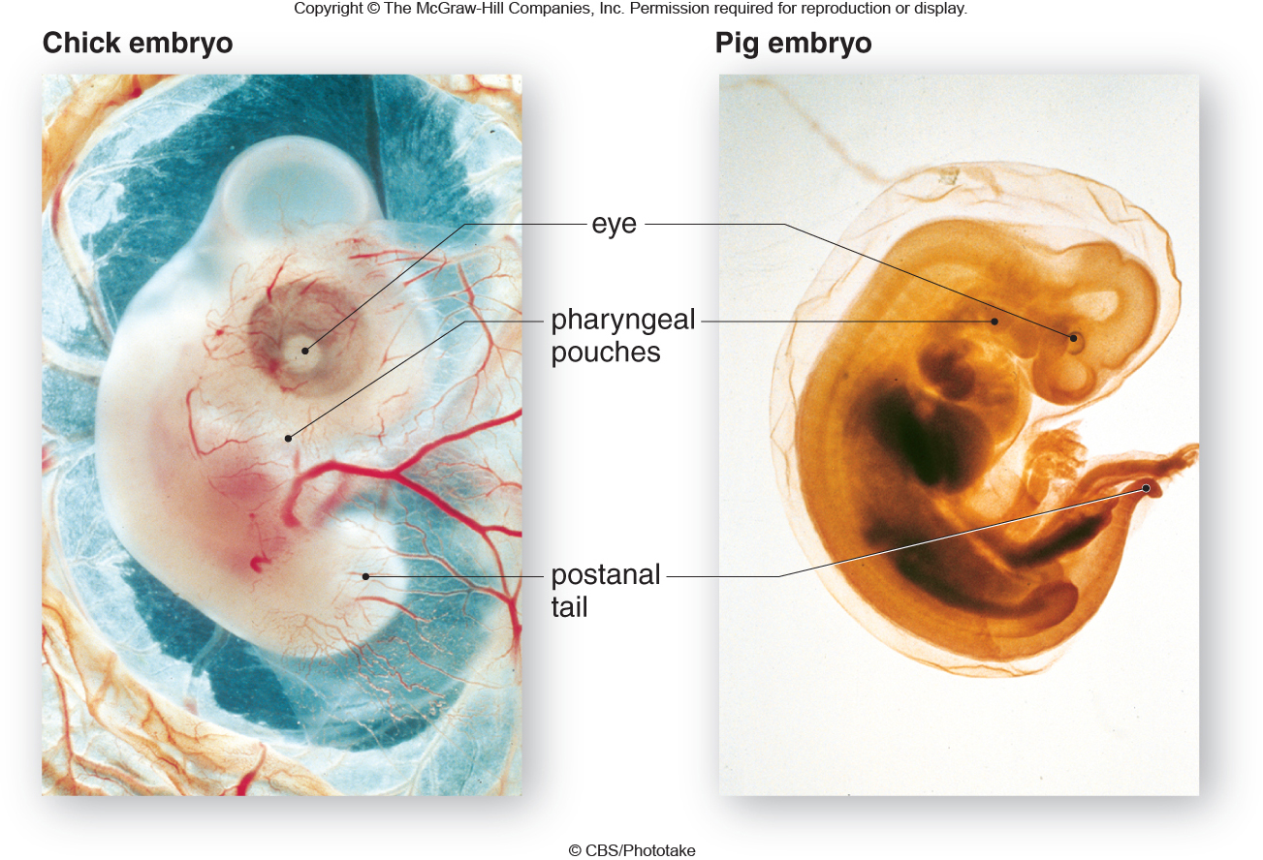
Anatomical evidence:
There are basic designs that have been copied (conserved) with modification over time. You can see it directly in the development of animals.
You can see it directly in the similarity of limbs of animals…

Slide 34
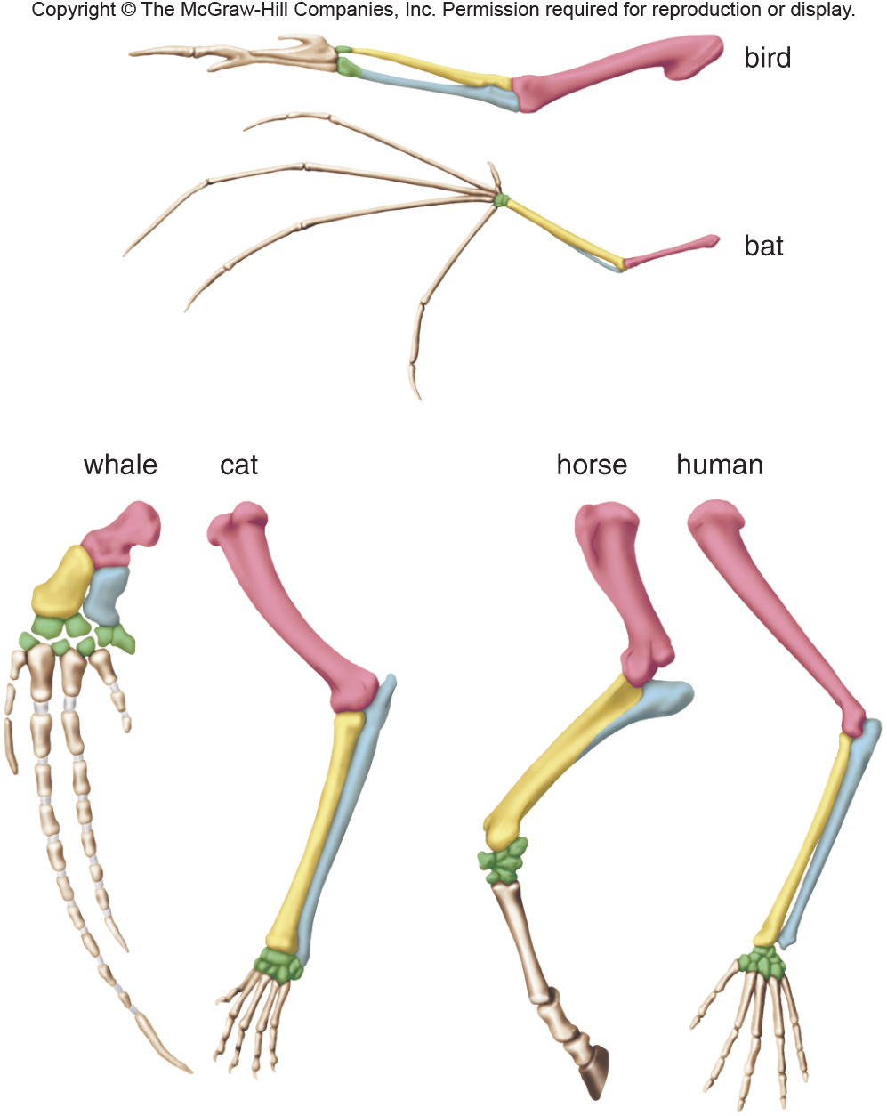
Fig. 14.15

Slide 35
Again, Neil Shubin’s book, helped me understand this in an easy to see way!

Slide 38
DNA (molecular) evidence
The powerful techniques of genomics and proteomics add unequivocal evidence for the relatedness of species.
Recall, at the DNA level, we share 98% of our sequence with other primates, like chimpanzees.
92% similarity with mice.

Slide 39
The more common the biological process the more similar we are!
There are genes that have been kept the same, conserved, back to those first life forms.
These genes control the basic things, common to all life---such as obtaining energy.

Slide 40
The final figure shows a comparison of several seemingly unsimilar organisms. The figure simulates how scientists decide on branches in phylogenetic trees.
All the organisms can branch from one branch because of a related gene, cytochrome C---which is used in metabolism.

Slide 41
The more related the closer in sequence are the cytochrome c genes!
Cytochrome C is needed for the electron transport chain—for making ATP! All eukaryotic organisms to this pretty much the same way…So it is a conserved gene/protein.

Slide 42
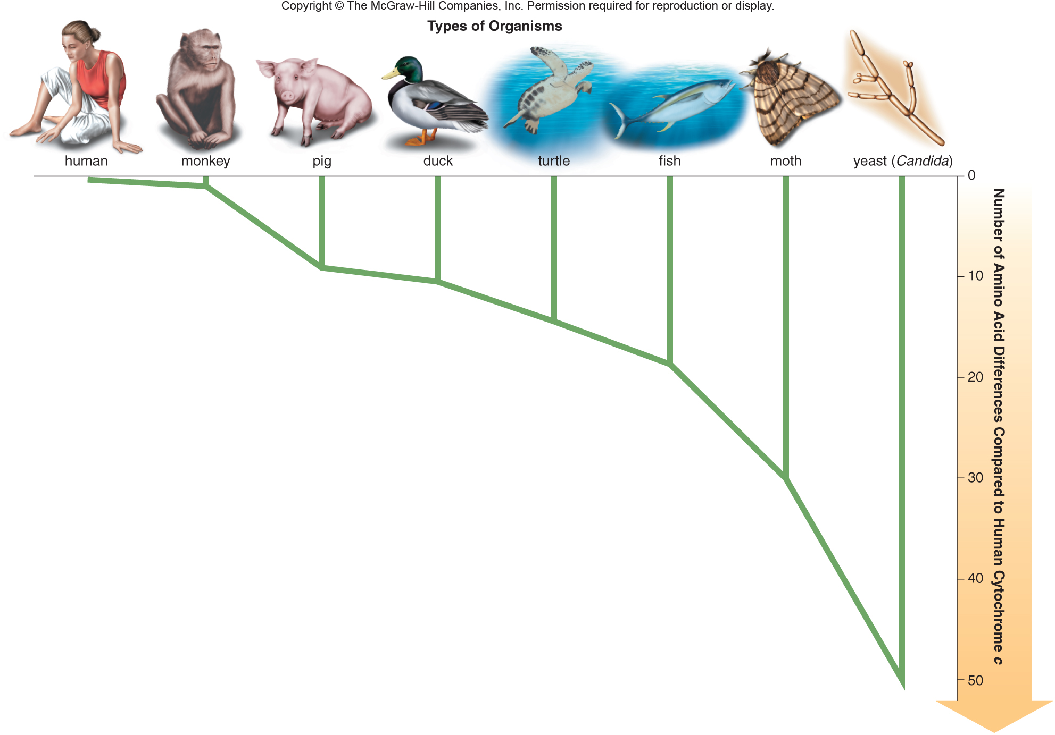
Fig. 14.17

